Slide 1
AI & ML to Detect Fraudulent Job Adverts
PREPARED BY:
ALICE Brennan
Wael Eladham
Cillian Murphy

Slide 2


Framing the Problem
Fraudulent Job Adverts
Target new and returning entrants to job market
Sophisticated, legitimate in appearance, appear on many platforms
Risk of Identity Theft
Risk of Fraud
Reputation and Resources

Slide 3
Similar Work and Methods
EMSCAD dataset has been used in academic research. Previous work on fake job detection use natural language processing techniques such as tf-idf and use classifiers like Logistic Regression and Naïve Bayes. BERT has also been used for models similar to what we will be building.

Slide 4



Dataset – Alice
Employment Scam Aegean Dataset(EMSCAD)
Developed by: University of the Aegean (Greece)
Sourced via Kaggle
18,000 job postings
Approx 5% labelled Fraudulent
Binary Classification
Planned Split: Train 80%, Test 20% (stratified)

Slide 5
Dataset – Wael
Fake-Job-Posting-Detection
Sourced via Kaggle
~54,000 job postings
Has a labeled and unlabeled version
Approx 5% labelled Fraudulent
Binary Classification
Planned Split: Train 80%, Test 20% (stratified)

Slide 6
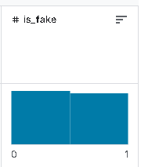
Dataset – Cillian
Title: Real vs Fake Job Postings
Synthetic dataset made to replicate patterns found in legitimate and fraudulent online job postings
Sourced from Kaggle - here
3,000 job postings
1472 fraudulent and 1528 real job listings
Contains 25 features including the class
Synthetic but contains real world patterns
NLP
Binary Classification (is_fake class)
20% test 80% train split, will be stratified.

Slide 7
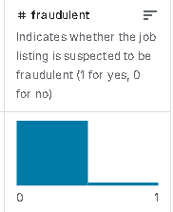
Dataset – Cillian - 2
Title: Real/Fake Job Listings
Taken from various sources and industries
Sourced from Kaggle - here
8,941 job postings
456 fraudulent postings
Contains 8 features including the class
NLP
Binary Classification (Fraudulent class)
20% test 80% train split.

Slide 8
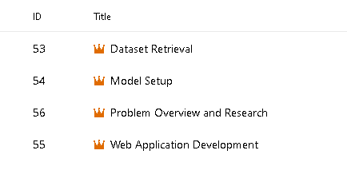
Azure DevOps Plan - Epics

Slide 9
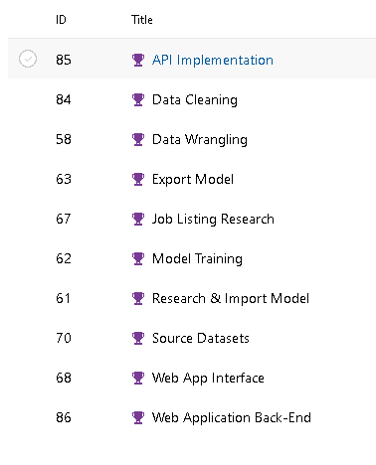
Azure DevOps Plan - Features

Slide 10
Thank You for Reading our Deck.

